Slide 1
Support Vector Machine
Thanh-Giang Tan Nguyen,
Dao Bac
Course: AB-403
Machine Learning
Instructor: Phuc Loi Luu, PhD
p.luu@garvan.org.au
luu.p.loi@googlemail.com
Adapted and modified from:
https://hastie.su.domains/MOOC-Slides/svm.pdf
https://machinelearningcoban.com/

Slide 2
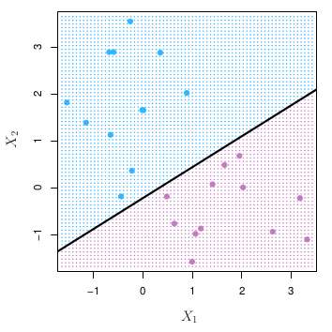
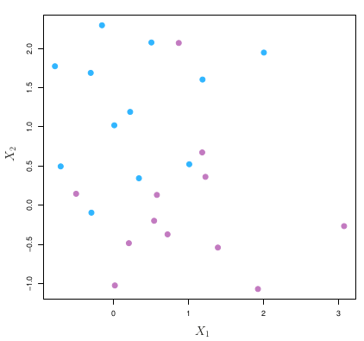
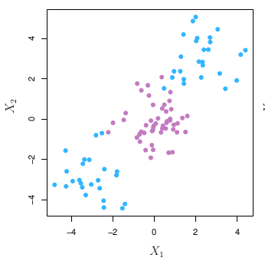
00.Backgrounds
0.1 The ideas of classifier technique in Support Vector Machine (SVM)
Linearly separable
Nearly Linearly separable
Non-Linearly separable
Maximal Margin Classifier
Support Vector Classifier
SVM
Soft-margin SVM
Kernel SVM

Slide 3
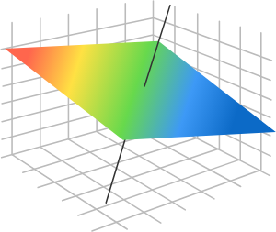
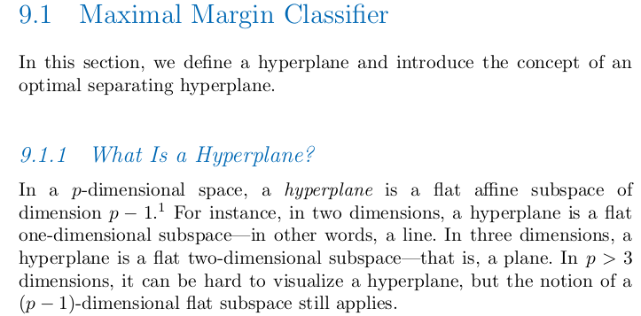
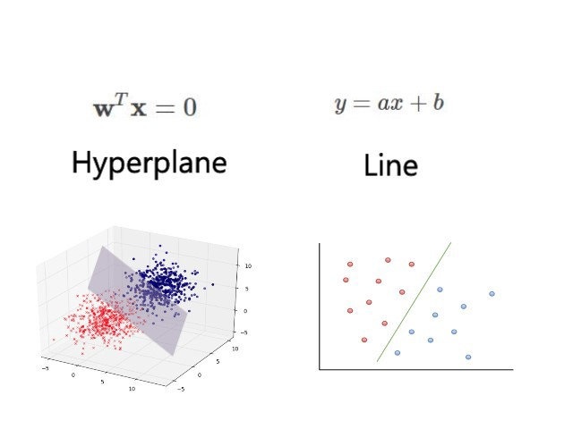
00.Backgrounds
0.2 Maximal Margin Classifier and Hyperplane
3D
=> The hyperplan can be rewritten as the form of linear algebra:
x+y-z=0=>[1,1,-1][x,y,z]=0
Note: the fomula is not correct in the right form. Get the idea is more important.

Slide 4
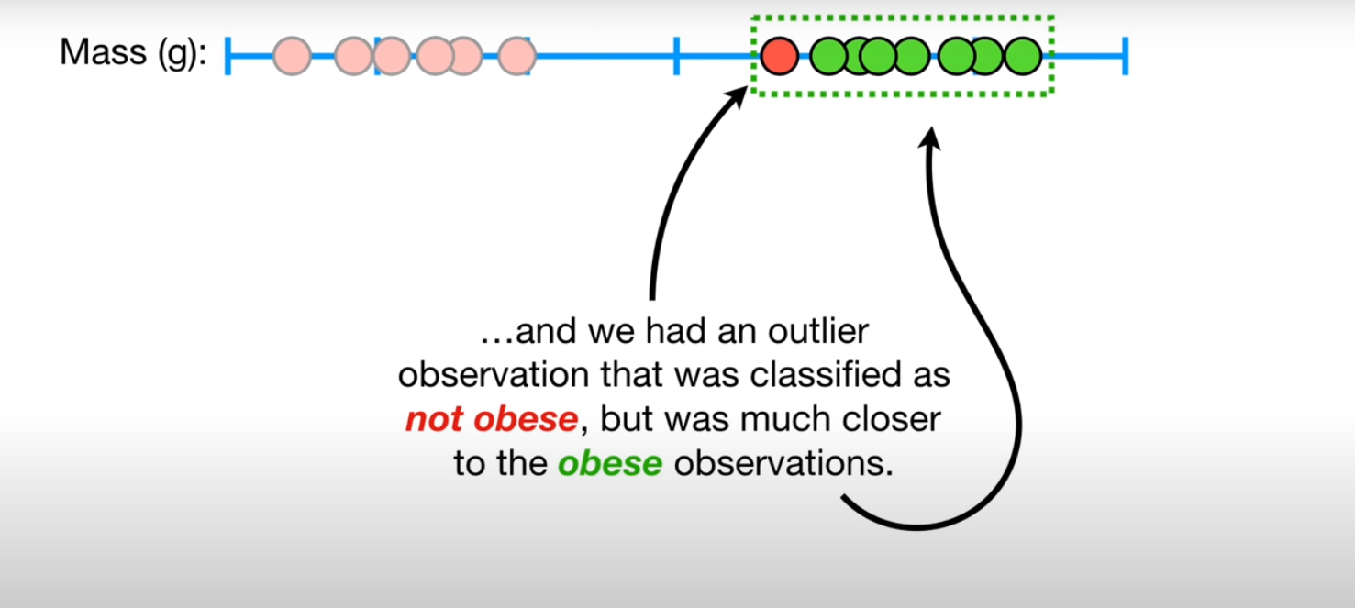
00.Backgrounds
0.3 Maximal Machine Classifier Example in 1D: Using mass to predict obese status.
=> For 1D. It is just a threshold (cut off values)
https://www.youtube.com/watch?v=efR1C6CvhmE

Slide 5
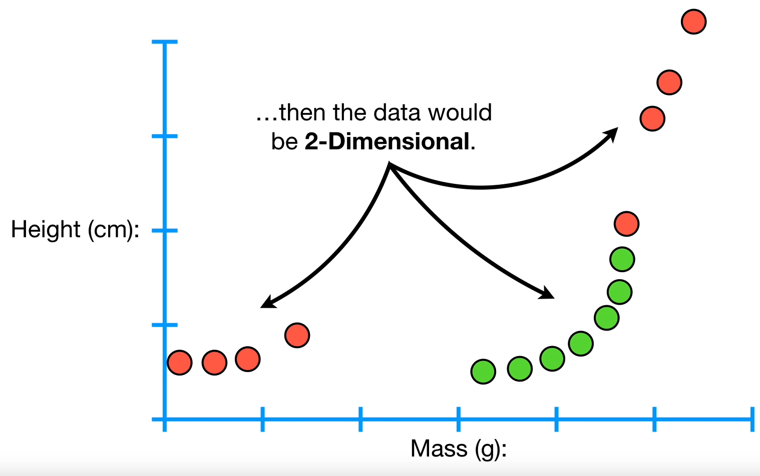
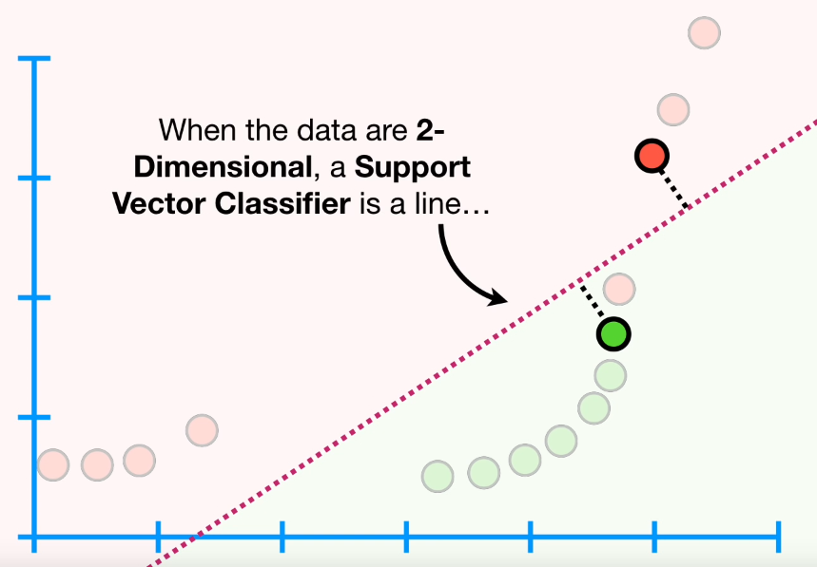
00.Backgrounds
0.4 Maximal Machine Classifier Example in 2D: Using mass and height to predict obese status.
=> For 2D. It is just a line
=> Using the line above can well classified between red and green dot. However, it is not optimized base on the maximal machine classifier.

Slide 6
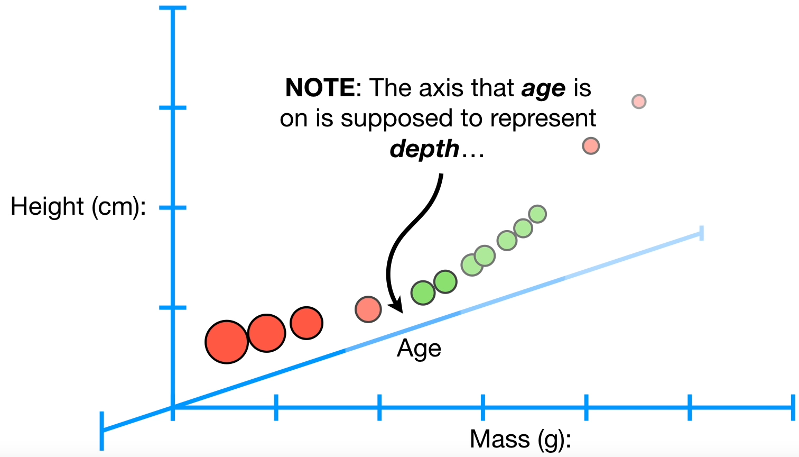
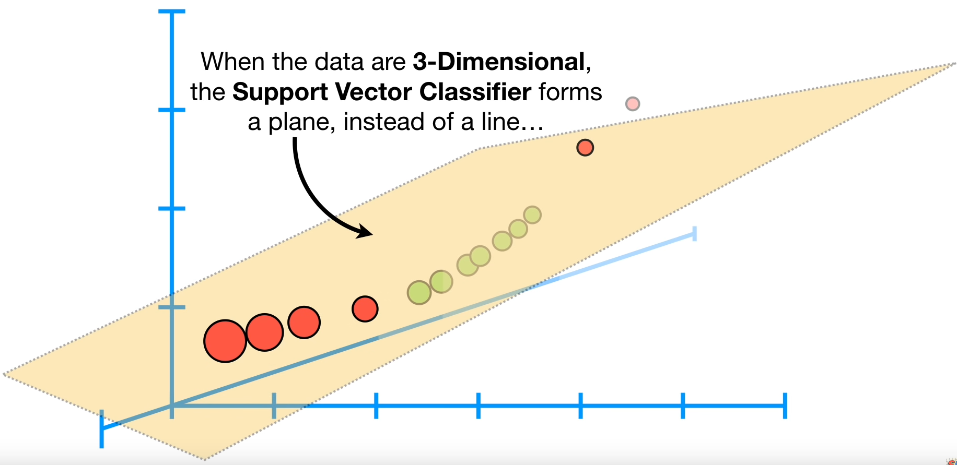
00.Backgrounds
0.5 Maximal Machine Classifier Example in 3D or more: Using mass, height and age to predict obese status.
=> For 3D or more features. It can be called as hyperplan.
=> Using the hyperplan above can well classified between red and green dot. However, it is not optimized base on the maximal machine classifier.

Slide 7
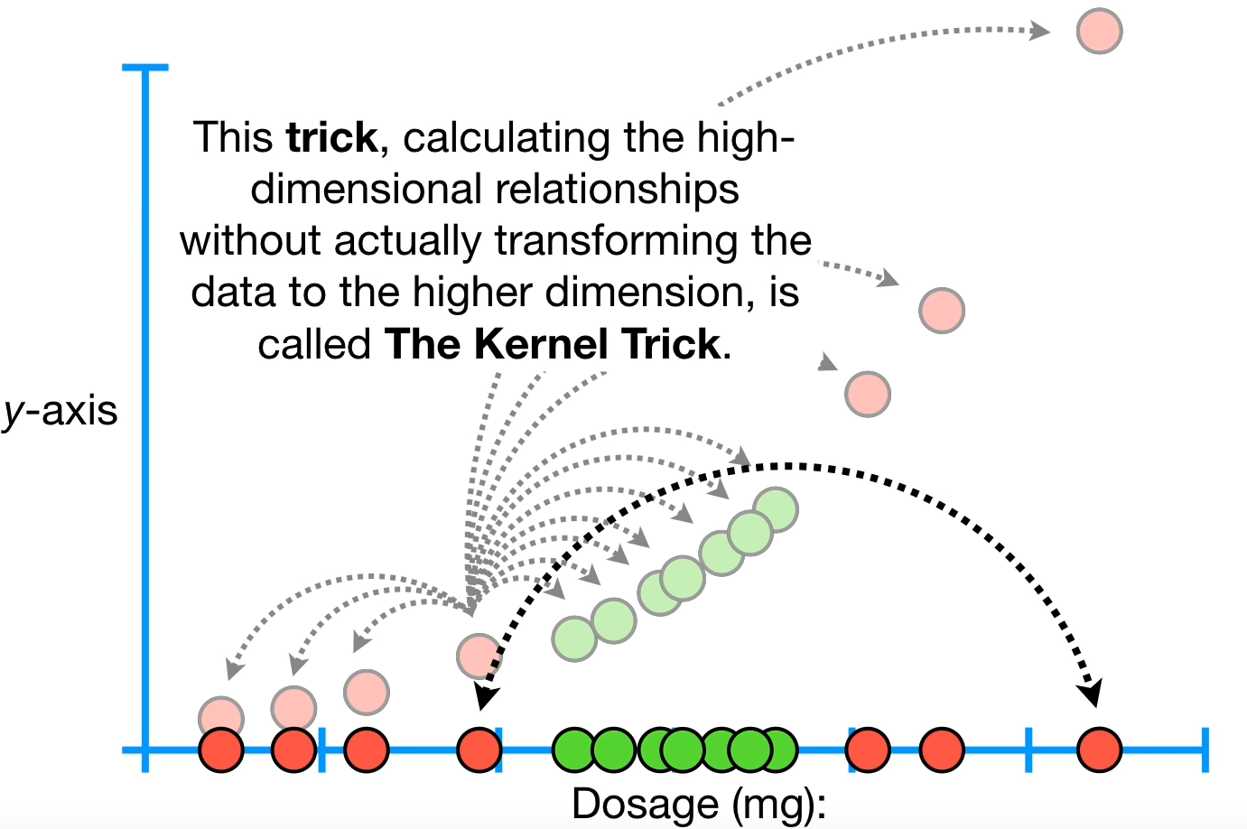
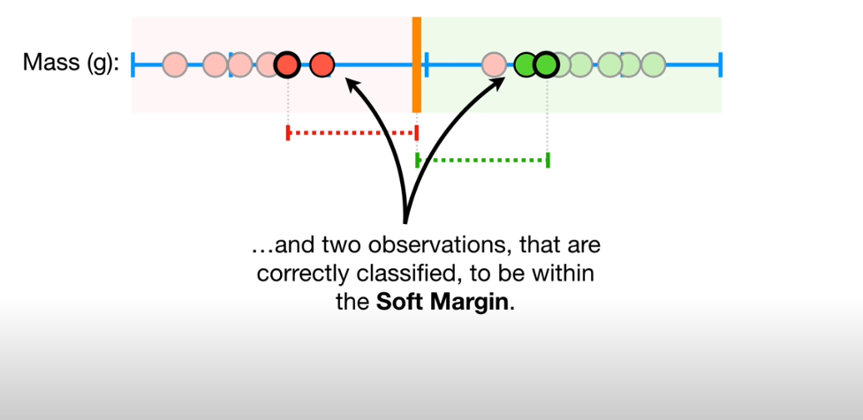
00.Backgrounds
0.6 Problem where data has the outliers or too much outliers.
=> For 3D or more features. It can be called as hyperplan.
=> Using the hyperplan above can well classified between red and green dot. However, it is not optimized base on the maximal machine classifier.

Slide 8
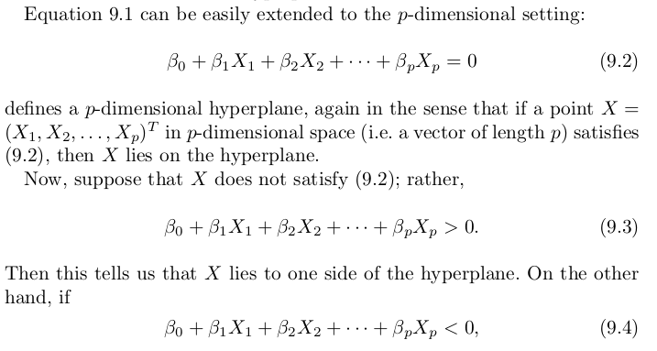
1. Derive SVM:
1.1 Formula of hyperplan and characteristic of hyperplan

Slide 9
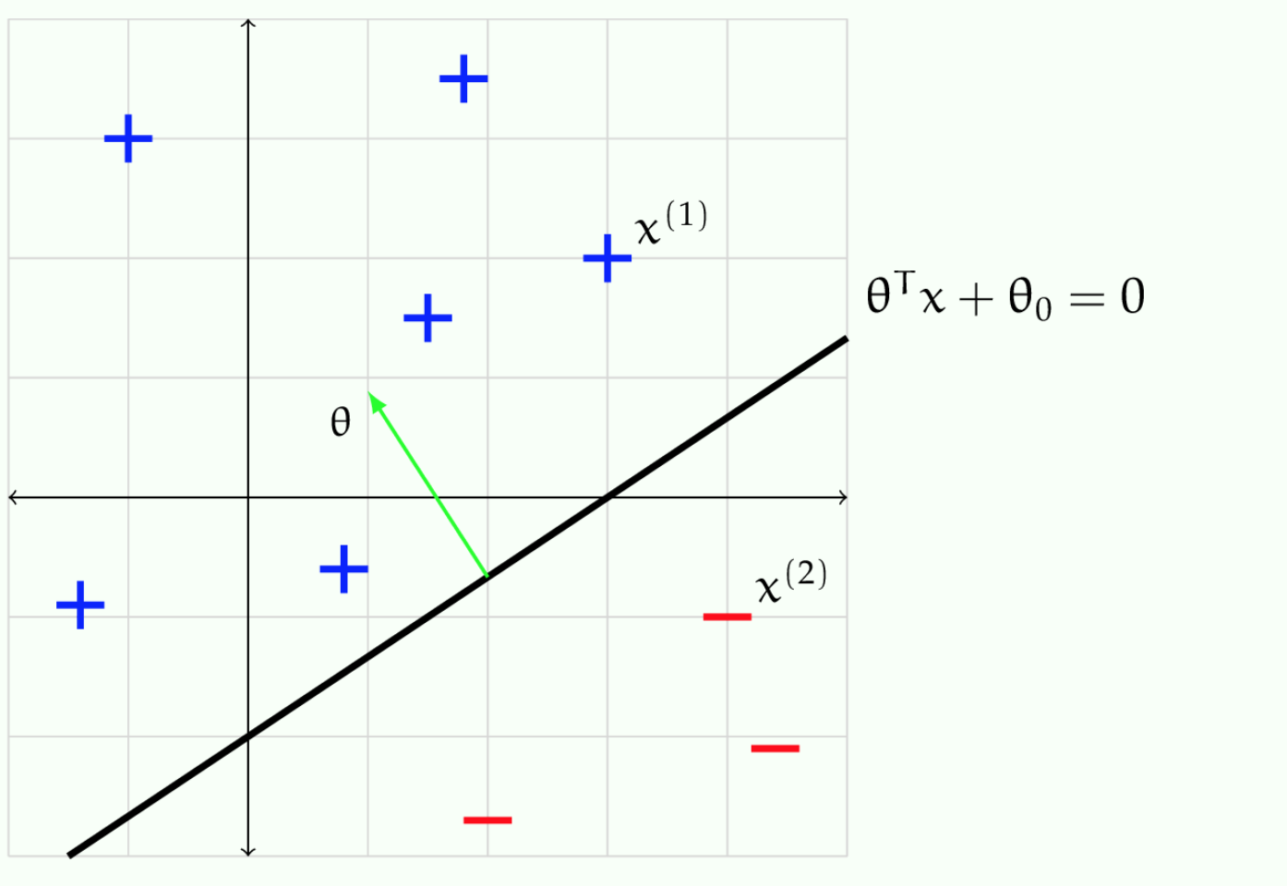
1. Derive SVM:
1.1 Formula of hyperplan and characteristic of hyperplan
=> For 2D: If an x0 is assigned on the line f(x),The value of f(x):
+ “=0”: On the line
+ “>0”: Above the line
+ ”<0”: Below the line
Ex: f(x)=y=x (the red line) => y-x=0
A(0,0), B(1,1) C(2,1) D(1,4)

Slide 10
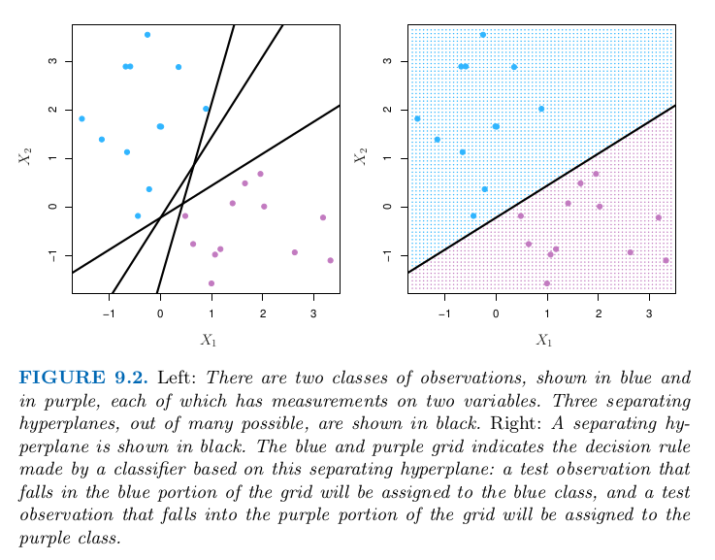
1. Derive SVM:
1.2 Optimize the hyperplan:
- There are many hyperplan can be used => Optimize.

Slide 11
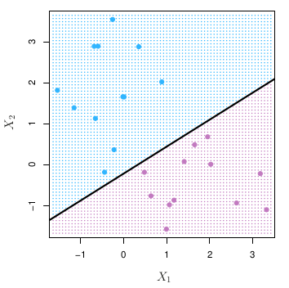
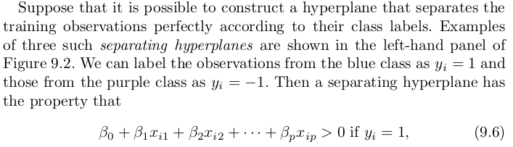
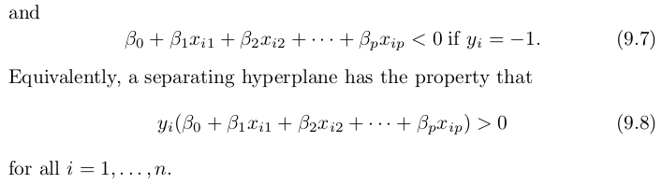
1. Derive SVM:
1.2 Optimize the hyperplan:
- There are many hyperplan can be used => Optimize.
a1>0, b =1 =>a1*b >0
a2<0, b=-1 =>a2*b >0
Let’s take a1=3,a2=-3

Slide 12
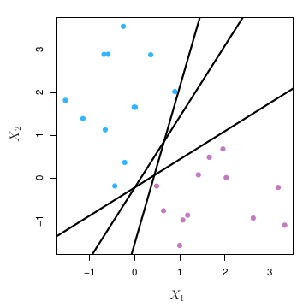
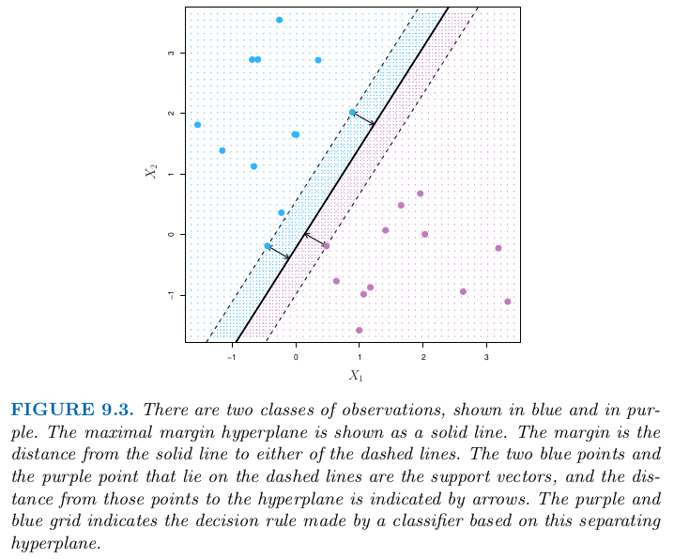
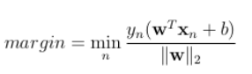
1. Derive SVM:
WHAT IS MARGIN?
1.2 Optimize the hyperplan:
- The smallest distance between the nearest points.

Slide 13
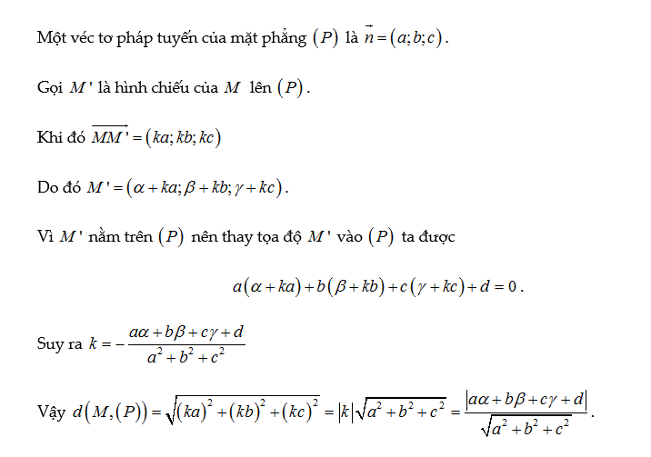
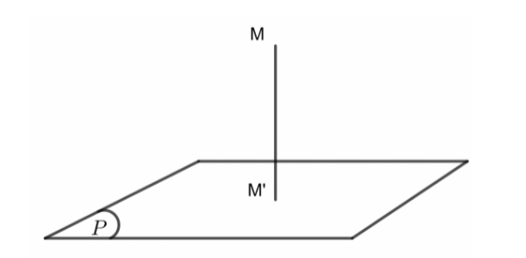
1. Derive SVM:
1.2 Optimize the hyperplan:
- Distance from a point to a hyperplan:

Slide 14
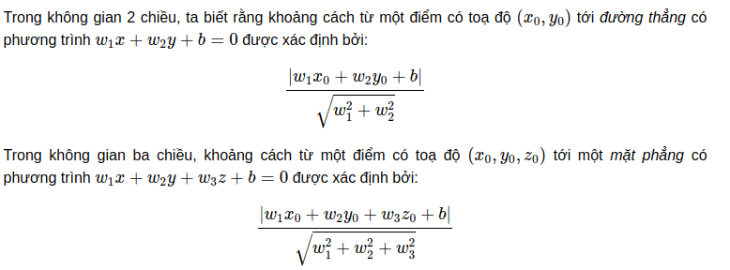
1. Derive SVM:
1.2 Optimize the hyperplan:
- Distance from a point to a hyperplan:

Slide 15
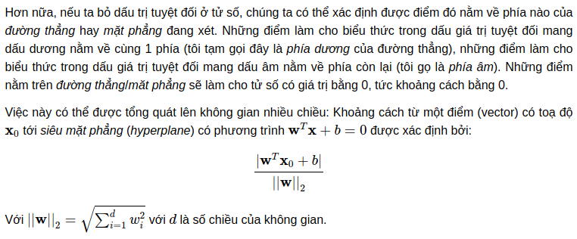
1. Derive SVM:
1.2 Optimize the hyperplan:
- Distance from a point to a hyperplan:
- Linear Algebra expression:

Slide 16

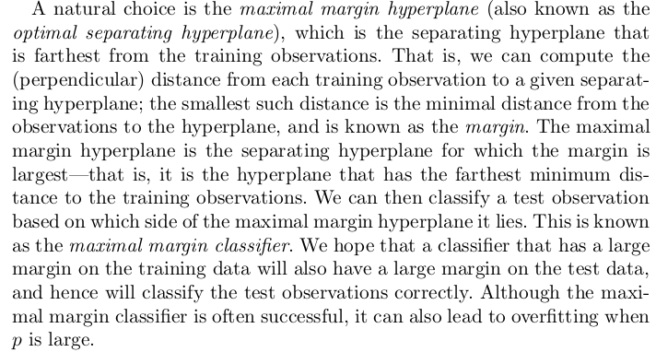
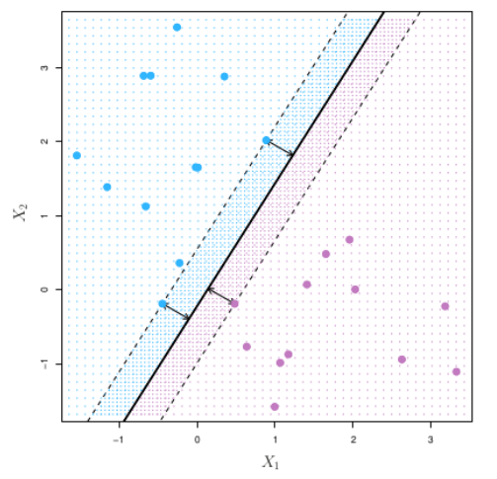
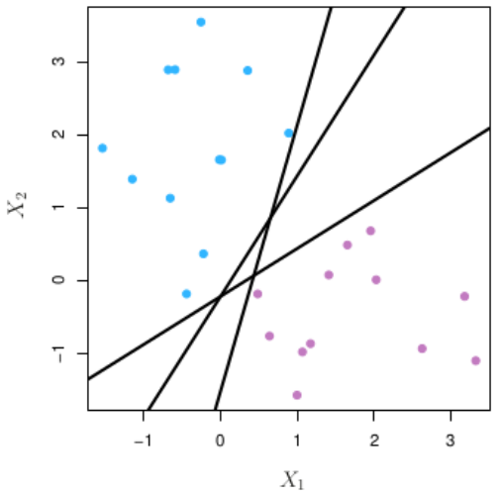
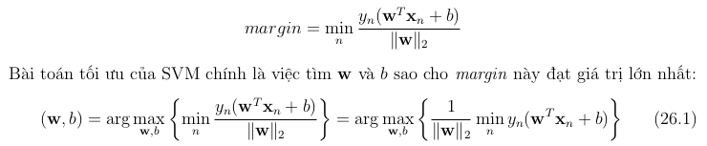
1. Derive SVM:
1.2 Optimize the hyperplan:
Note: Khoảng cách từ 1 điểm gần nhất trong 2 điểm đến mặt phẳng. Margin tới 2 class là bằng nhau.

Slide 17
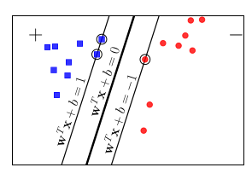
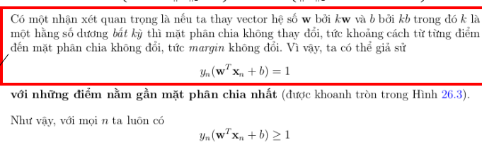
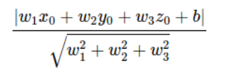
1. Derive SVM:
1.2 Optimize the hyperplan:
Ex:
(I) y-x+1=0 ,k=2,k=1,A(1,1)
<=> 2(y-x+2)=0 <=>2(y-x)+2=0
k=1:
D(A,I)=|1-1+1|/sqrt(1^2+1^2)
k=2:
D(A,I)=|2-2+2|/sqrt(2^2+2^2)
Therefore,can multiply k to adjust the below equation to 1.

Slide 18
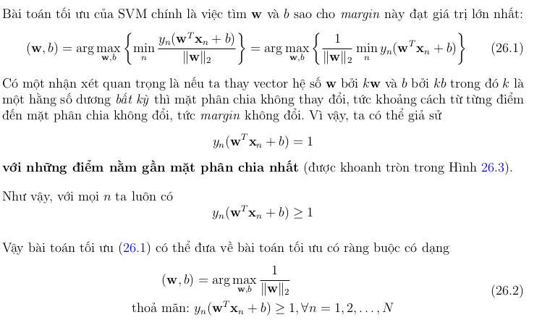
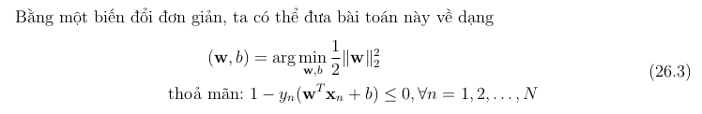
1. Derive SVM:
1.2 Optimize the hyperplan:
Ex:
y-x+1=0 ,k=2
<=> 2(y-x+2)=0 <=>2(y-x)+2=0

Slide 19
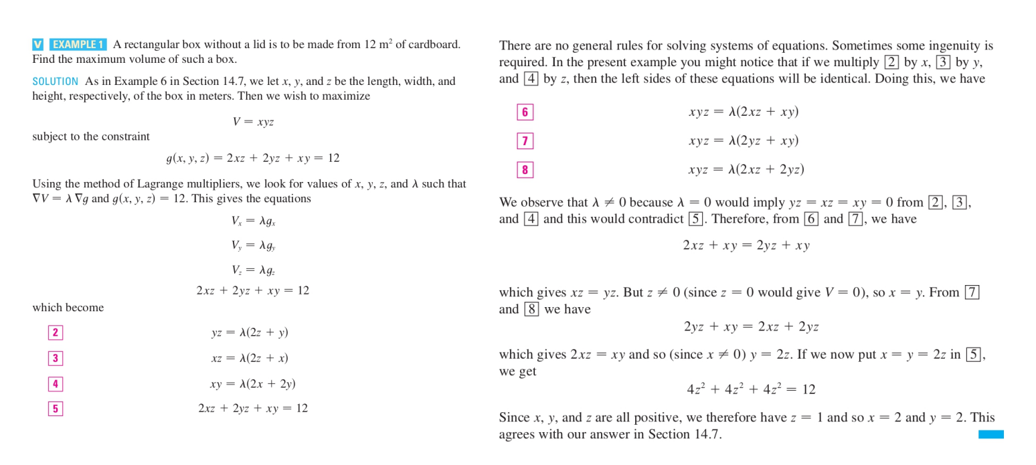
1. Derive SVM:
1.2 Optimize the hyperplan:

Slide 20
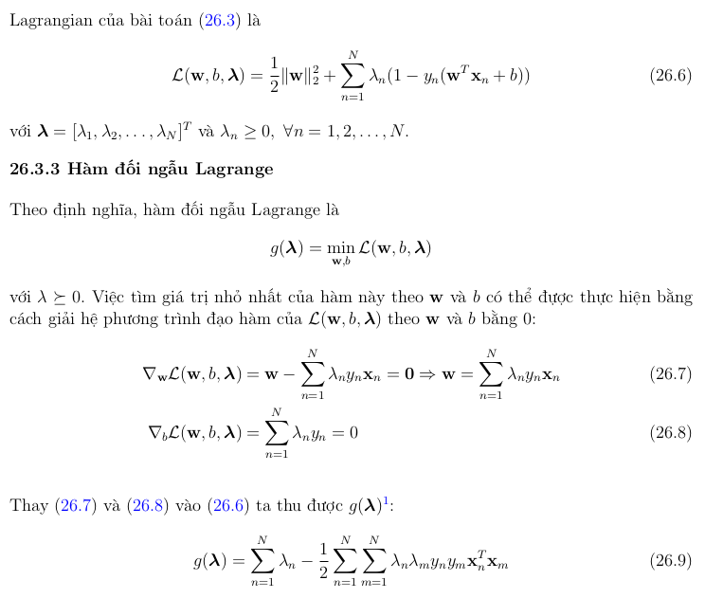
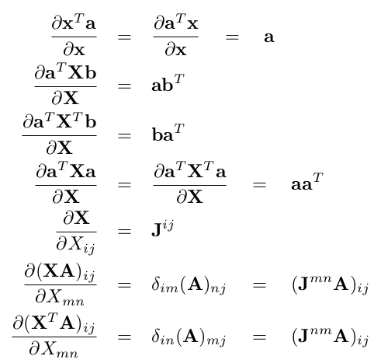
1. Derive SVM:
1.2 Optimize the hyperplan:
(4)

Slide 21
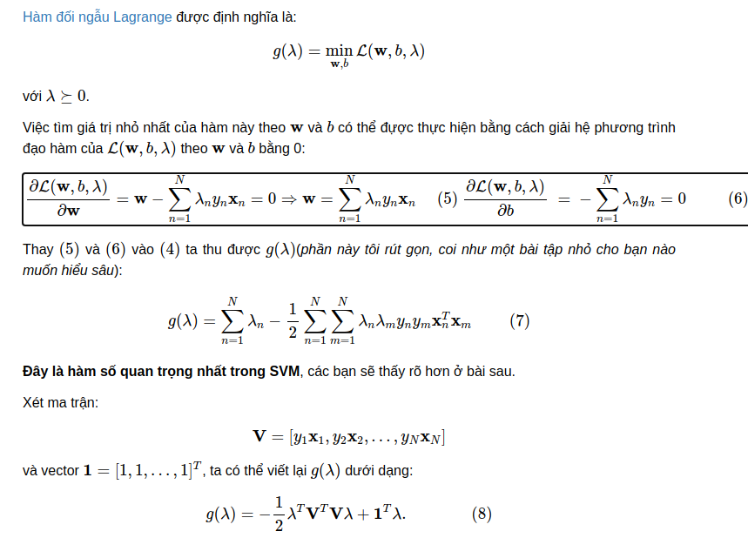
1. Derive SVM:
1.2 Optimize the hyperplan:
Note: From (8), we can find the solution which is the hyperplan that fit the models

Slide 22
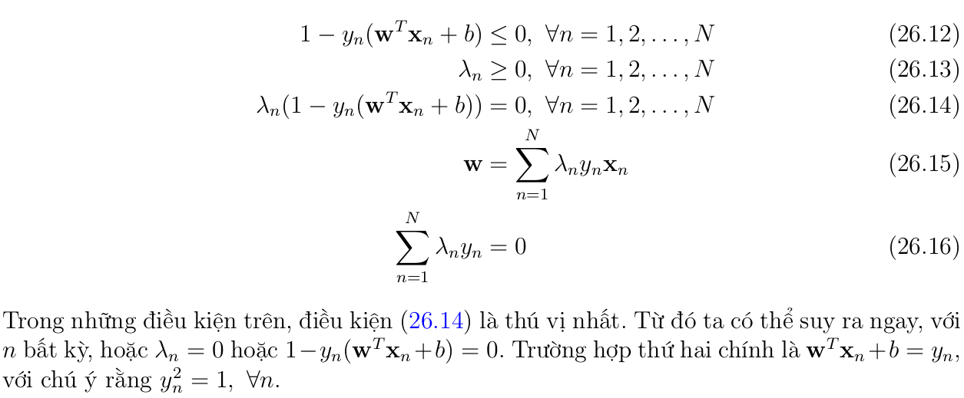
1. Derive SVM:
1.2 Optimize the hyperplan:

Slide 23
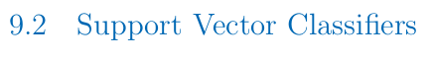
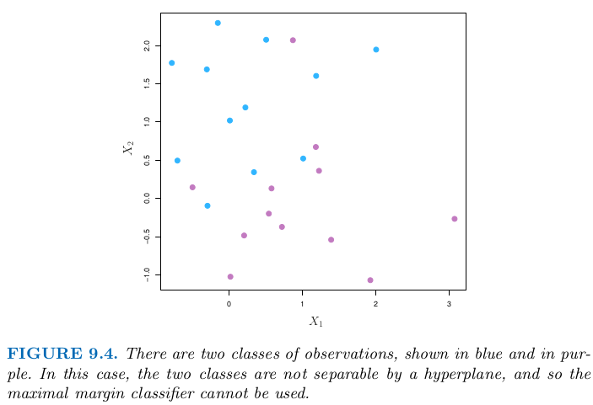
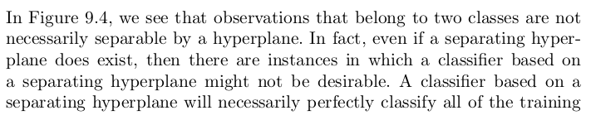
1. Derive SVM:
1.2 Optimize the hyperplan:

Slide 24
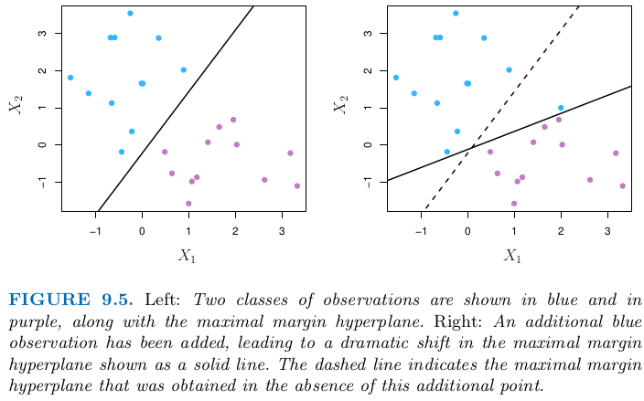
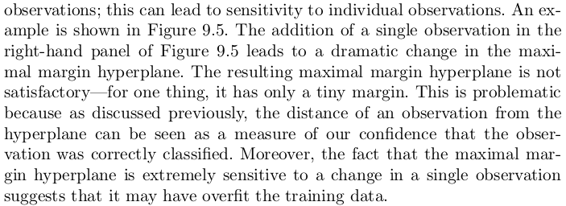
1. Derive SVM:
1.2 Optimize the hyperplan:

Slide 25
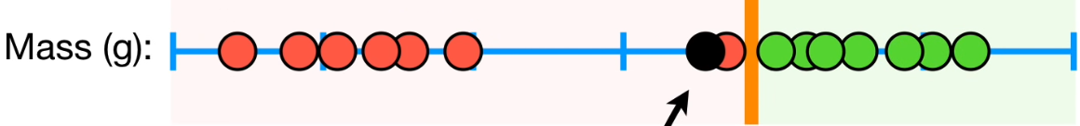
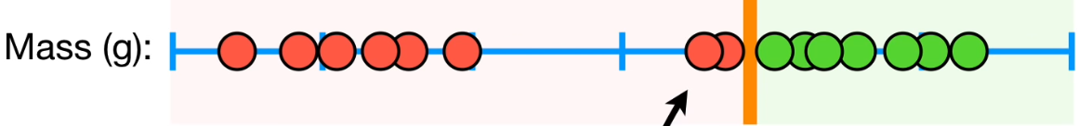
1. Derive SVM:
1.2 Optimize the hyperplan:

Slide 26
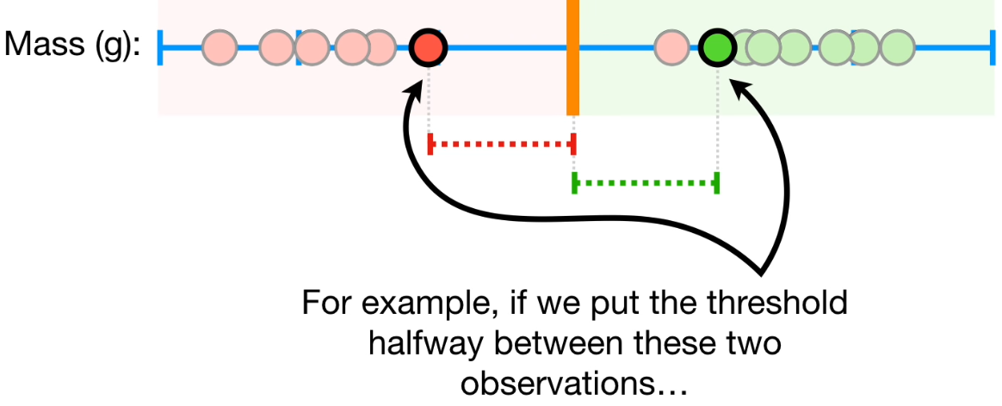
1. Derive SVM:
1.2 Optimize the hyperplan:

Slide 27
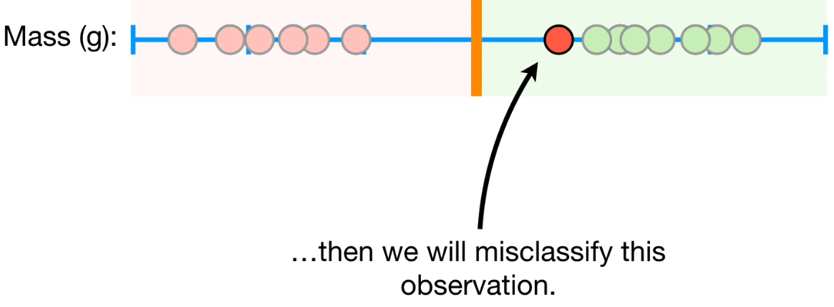
1. Derive SVM:
1.3 Optimize the hyperplan, soft margin classifier:

Slide 28
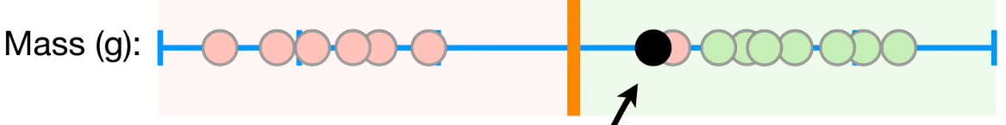

1. Derive SVM:
1.3 Optimize the hyperplan, soft margin classifier:

Slide 29

1. Derive SVM:
1.3 Optimize the hyperplan, soft margin classifier:

Slide 30

1. Derive SVM:
1.3 Optimize the hyperplan, soft margin classifier:

Slide 31



1. Derive SVM:
HINGE LOSS
1.2 Optimize the hyperplan:

Slide 32


1. Derive SVM:
1.3 Optimize the hyperplan, soft margin classifier:

Slide 33


1. Derive SVM:
1.2 Optimize the hyperplan:

Slide 34

1. Derive SVM:
1.2 Optimize the hyperplan:

Slide 35

1. Derive SVM:
1.2 Optimize the hyperplan:

Slide 36



Slide 37

1. Derive SVM:
1.3 Kernal SVM, whenever, it is not linearly sperated.
https://goo.gl/3wMHyZ

Slide 38

1. Derive SVM:
1.3 Kernal SVM, whenever, it is not linearly sperated.

Slide 39

1. Derive SVM:
1.4 Kernal SVM, whenever, it is not linearly sperated.

Slide 40



1. Derive SVM:
1.4 Kernal SVM, whenever, it is not linearly sperated.

Slide 41

1. Derive SVM:
1.4 Kernal SVM, whenever, it is not linearly sperated.

Slide 42

1. Derive SVM:
1.4 Kernal SVM, whenever, it is not linearly sperated.

Slide 43

1. Derive SVM:
1.4 Kernal SVM, whenever, it is not linearly sperated.

Slide 44
1. Derive SVM:
1.4 Kernal SVM, whenever, it is not linearly sperated.

Slide 45

1. Derive SVM:
1.4 SVM and Neureal nework comparison.

Slide 46
1. Derive SVM:
1.4 SVM and Neureal nework comparison.

Slide 47


2.Practice:
2.1. Download and read the basic information of the processed data and model from https://www.ncbi.nlm.nih.gov/geo/query/acc.cgi?acc=GSE164174

Slide 48

2.Practice:
2.2. What are the models that they used to classify ?

Slide 49

2.Practice:
2.3. Create 2 files required for classification tasks:
+ Clinical.txt: At least has 2 columns: sample and target
+ Data.txt: The first columns is sample while remaining are the processed gene expression matrix.
Row are patients and column are gene.
Note:
+ sample are ID of patients, target are labels of 2 groups and need to tranform to binary (0-1) by excel or using packages.

Slide 50


2.Practice:
2.4. Create 2 files required for classification tasks:
+ Clinical.txt: At least has 2 columns: sample and target
+ Data.txt: The first columns is sample while remaining are the processed gene expression matrix.

Slide 51
2.Practice:
2.5. Combine data into final.txt. Just merge the data.txt with the clinical.txt keep the target columns in the final columns.
2.6. Giang: Explain Workflow, Scripts using Python.
source:https://colab.research.google.com/drive/1AONLgcTRaKbeIoeXWO0PE-Wb8aRL92gc?usp=sharing

